Slide 1

MOVIE DOMESTIC % GROSS

Slide 2
The movie reviews website was very happy with your deliverable for the previous assignment and now they have a new request for you.
The previous consultant had created a chart for them which is illustrated on the next slide. However, the R code used to create the diagram has since been lost and cannot be recovered. Your task is to come up with the code that will re-create the same chart making it look as close as possible to the original

Slide 3
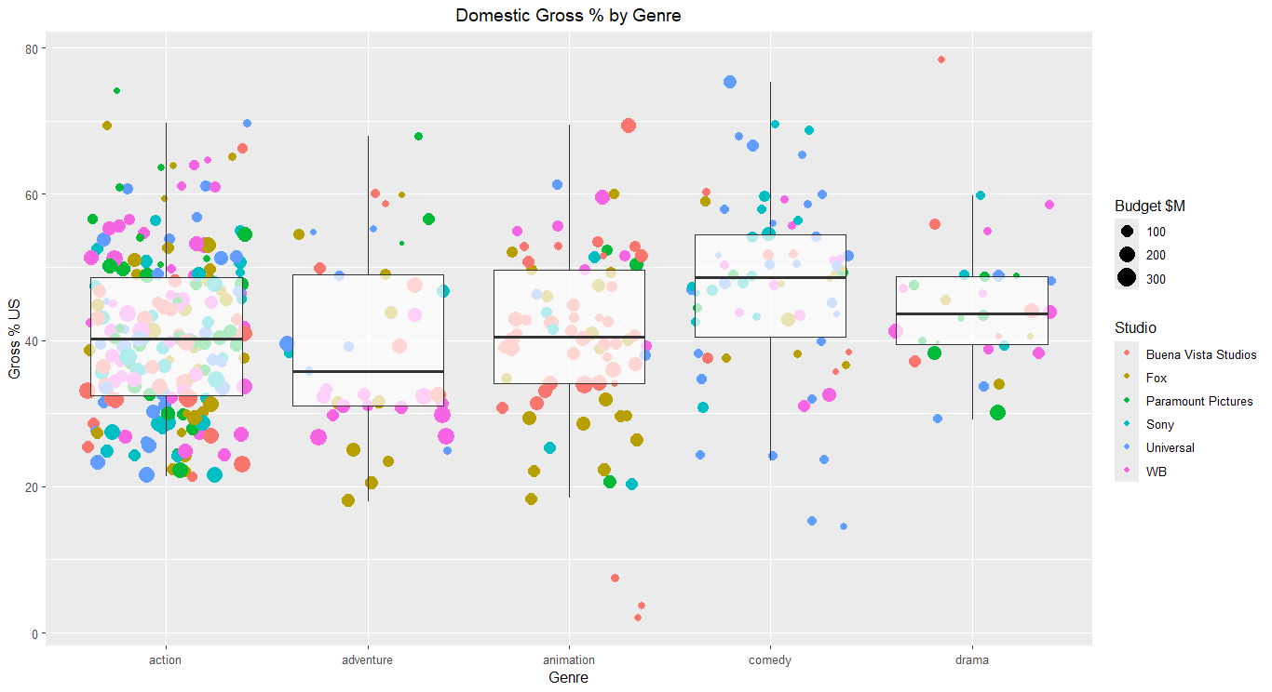
Notes:
Using the provided data and reconstructed R code, we recreated the original chart to visualize trends in movie gross distribution.
The updated chart reflects an accurate representation of the domestic vs. international gross balance across various films.

Slide 4
CONCLUSION

Slide 5
Domestic Gross Performance
The analysis highlights the distribution of movie domestic grosses, showing the financial success of films in their respective regions.
The domestic gross percentage helps to understand which films performed well in the local market compared to their overall international gross.

Slide 6
Insights
High Domestic Gross: Films with higher domestic percentages tend to have stronger local appeal, potentially influenced by cultural relevance, star power, or marketing.
1
Low Domestic Gross: Movies with a lower percentage of domestic gross likely benefited from a broader international audience, indicating either global appeal or weaker domestic performance.
2

Slide 7

Final Takeaways
Understanding domestic and international gross proportions can guide future decisions in movie production, marketing, and distribution strategies.
By identifying patterns in movie performance, studios can target markets better and maximize revenue potential.

